Slide 1


Technological Implications
of an
Open Biodiversity Knowledge Management System
(OBKMS)
Viktor Senderov
PhD Candidate at Pensoft Publishers & Bulgarian Academy of Sciences (BAS)
Affiliation: Pensoft Publishers
Supervisor: Prof. Lyubomir Penev
14.10.2016

Slide 2

Main objectives of the project
PhD project plan published as part of an open thesis.
Objectives:
Models and workflows for import, peer-review, and publishing of structured biodiversity data
A general semantic model of a biodiversity publication
A Biodiversity Knowledge Graph
Competency questions and use-cases
Notes:
Model : theoretical investigation, development of a hypothesis/ concept
Knowledge graph: proof of concept
Competency questions: practical evaluation of the usefulness of the model

Slide 3
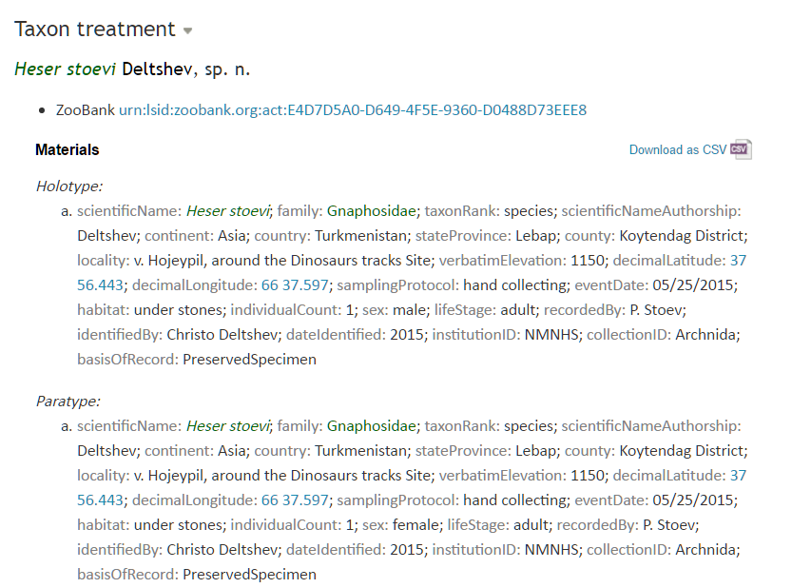
GRAPH DATABASE
Name
Identification
Scientific name
Has Identification
Occurrence
Organism
LINKED
OPEN
DATA
Occurrence Of
Location

Slide 4
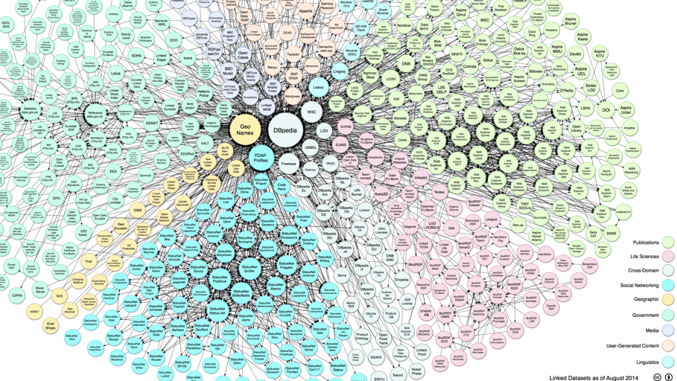
Methodology
Ontology engineering to create the model
Semantic Web technologies to create the knowledge graph
Data mining to answer competency questions
Notes:
"Linking Open Data cloud diagram 2014, by Max Schmachtenberg, Christian Bizer, Anja Jentzsch and Richard Cyganiak. http://lod-cloud.net/"

Slide 5
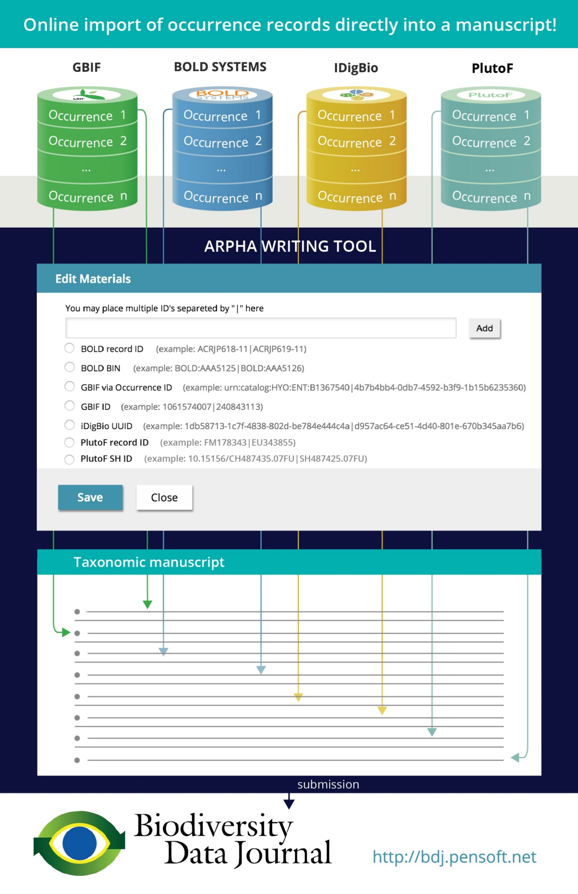
Main results obtained so far
Data import workflows (aggregators) for structured biodiversity data and novel article types
Automated creation of data paper manuscript from EML metadata
Decision on which ontologies to use and what to further develop
A preliminary semantic model of a biodiversity publication and examples of nano-publications
A prototype of the Biodiversity Knowledge Graph
Notes:
Evaluated the coverage of different ontologies and vocabularies available on-line and decided which ontologies to use.
Identified “lapses” where coverage is lacking.
Created preliminary model for RDF-izing a biodiversity publication.
A preliminary version of the biodiversity knowledge graph deployed as a graph database.

Slide 6
My expectations on the possible impact of the action on my future career
Establish a good scientific reputation in the international biodiversity and bioinformatics communities thanks to networking, publications, and implementation of the OBKMS
Acquire new knowledge in computer science and biology
leading to
Research-oriented position at the intersection of artificial intelligence and biology
Notes:
Acquired qualifications:
Ontology engineering
Semantic Web development
Need to concentrate more on:
Pure biological knowledge, especially genomics
Data mining, data analysis, machine learning
High ranking publications

Slide 7
Next steps
Implementation of OBKMS
Linking of OBKMS to other domains, in particular genomics through secondment to ERA7
Planned publications:
“Semantic model of a biodiversity publication”
“Ontology population of OBKMS with Linked Open Data”
“Implementation, functionality, and architecture of the Open Biodiversity Knowledge Management System”

Slide 8

Journal articles published during action so far
Senderov V, Penev L (2016) The Open Biodiversity Knowledge Management System in Scholarly Publishing. Research Ideas and Outcomes 2: e7757.doi: 10.3897/rio.2.e7757
Faulwetter S, Pafilis E, Fanini L, Bailly N, Agosti D, Arvanitidis C, Boicenco L, Catapano T, Claus S, Dekeyzer S, Georgiev T, Legaki A, Mavraki D, Oulas A, Papastefanou G, Penev L, Sautter G, Schigel D, Senderov V, Teaca A, Tsompanou M (2016) EMODnet Workshop on mechanisms and guidelines to mobilise historical data into biogeographic databases. Research Ideas and Outcomes 2: e10445.doi: 10.3897/rio.2.e10445
Cardoso P, Stoev P, Georgiev T, Senderov V, Penev L (2016) Species Conservation Profiles compliant with the IUCN Red List of Threatened Species. Biodiversity Data Journal 4: e10356. doi: 10.3897/BDJ.4.e10356
Senderov V, Georgiev T, Penev L (2016) Online direct import of specimen records into manuscripts and automatic creation of data papers from biological databases . Research Ideas and Outcomes 2: e10617. doi: 10.3897/rio.2.e10617
Notes:
COLORS
BDJ LOGO
Utilizing Open science/ Open thesis
Feedback after the publication the publication of the phd plan – adapting the plan after recommendations

Slide 9
Presentations and events
Dates | Venue | Attendance (y/n) | Presentation (y/n)
June 2015 | EU BON, Cambridge, UK | Yes | No
June 2015 | EMODNET, Crete, Greece | Yes | No
July 2015 | BEXIS, Jena, Sofia | Yes | No
August 2015 | BOLD, Guelph, Canada | No | Yes (junior author)
September 2015 | BIG4, Copenhagen, Denmark | Yes | Yes
November 2015 | PlutoF Workshop, Sofia, BG | Yes | No
Oct – Feb 2015 | BAS, Sofia, Bulgaria | Yes (seminar) | Yes
March 2016 | EU BON, Sofia, Bulgaria | Yes | Yes
March 2016 | Plazi Workshop, Sofia, BG | Yes | No
April 2016 | Ontotext, Sofia, Bulgaria | Yes (technical meeting) | Yes
June 2016 | BIG4, Podiji, Czechia | Yes | Yes (3)
July 2016 | iDigBio + Pensoft Webinar | Yes (webinar) | Yes
July 2016 | Island Biology Conference, ESP | No | Yes (2, junior author)
August 2016 | IUCN, Hawaii, USA | No | Yes (junior author)

Slide 10
Planned presentations
December 2016: Biodiversity Informatics Standards (TDWG) 2016 Annual Conference:
Talk: “The Open Biodiversity Knowledge Management System: A Semantic Suite Running on top of the Biodiversity Knowledge Graph”
Computer demo: “Demonstrating the prototype of the Open Biodiversity Knowledge Management System”
Talk: “Nanopublications for biodiversity: concept, formats and implementation”
Talk: “Next generation publishing for biodiversity using Pensoft’s ARPHA writing tool and publishing system”
Computer demo: “Biodiversity Informatics Standards (TDWG)”
Computer demo: “Online Import of Occurrence Records into Manuscripts from Taxonomic Databases using Pensoft’s ARPHA* Writing Tool”
Computer demo: “Creation of Data Paper Manuscripts from Ecological Metadata Language (EML)”
Notes:
COLOR
Describe TDWG ROLE
Workshop
Feedback, testing

Slide 11










International collaboration
Notes:
Feedback and updates from leading biodiversity informatics groups in the world
Use the logos, graphic style
‘
Bulgarian Academy of Sciences: Institute for Information and Communication Technology, Institute for Biodiversity and Ecosystems Research
Plazi, Switzerland
BIG4 project patrners
Arizona State University
Illinois Natural History Survey
PlutoF, Estonia
Integrated Digitized Biocollections (iDigBio)
IUCN
Barcode of Life Systems
Global Biodiversity Information Facility
DataONE
Long Term Ecological Research (LTER) network

Slide 12
Other activities
Outreach:
8 posts in own blog: http://openbkms.blogsport.com
5 posts in the Pensoft blog: http://blog.pensoft.net
Social media activity (BIG4, own, and Pensoft accounts)
Webinar presentation with iDigBio
Courses and completed exams:
Introduction to taxonomy (Prof. Boyko Georgiev, Dr. Pavel Nikolov)
MATLAB course (BAS)
Language course
BIG4 course in the Czech Republic
Notes:
COLOR
Describe TDWG ROLE
Workshop
Feedback, testing

Slide 13
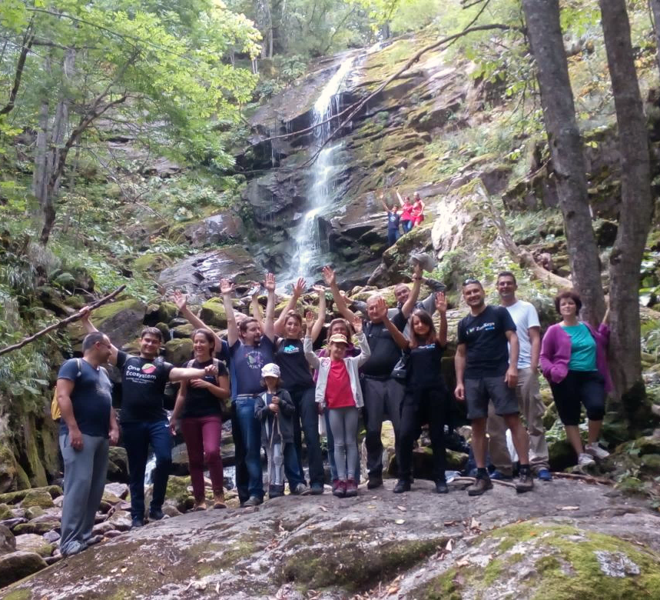
Thank you!
PhD Financed through the EU Marie-Sklodovska-Curie Program, Grant Agreement Nr. 642241
Advisor: Prof. Lyubomir Penev
Consultants:
Dr. Kiril Simov
Dr. Eamonn O’Tuama
BIG4 partners
All international collaborators:
Plazi
ASU
Illionis

